Slide 1


Walmart Sales Analysis
This presentation explores the sales data of Walmart, a retail giant
with a vast network of stores and online presence. We will delve into
a comprehensive analysis of sales trends, patterns, and key insights.
Generic Questions
Product questions
Sales Questions
Customer Questions

Slide 2

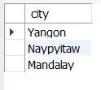
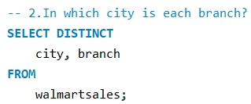

Business (Generic Questions)
Output
Output

Slide 3
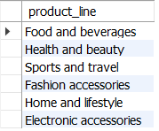



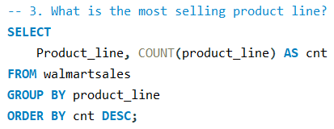
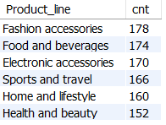
Business (Product Questions)
Output
Output
Output

Slide 4


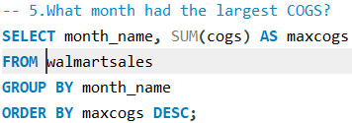

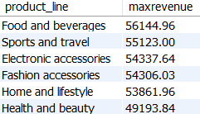

Business (Product Questions)
Output
Output
Output

Slide 5



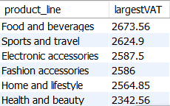
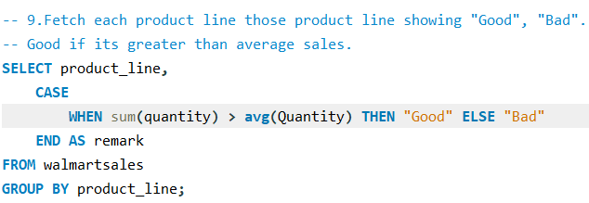
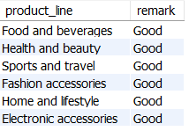
Business (Product Questions)
Output
Output
Output

Slide 6


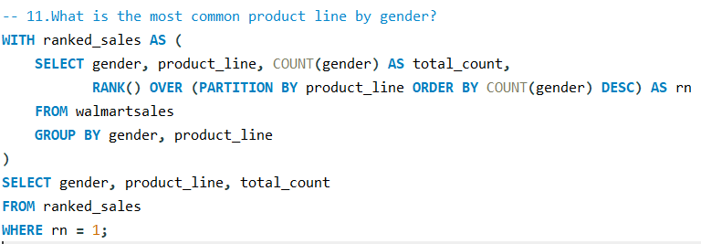
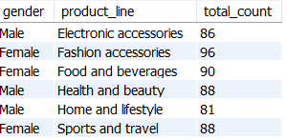
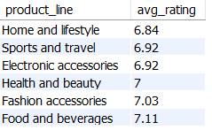

Business (Product Questions)
Output
Output
Output

Slide 7








Business (Sales Questions)
Output
Output
Output
Output

Slide 8








Business (Customer Questions)
Output
Output
Output
Output

Slide 9


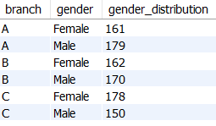



Business (Customer Questions)
Output
Output
Output

Slide 10
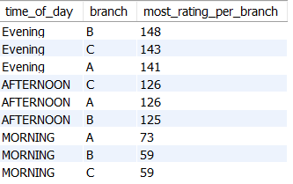





Business (Customer Questions)
Output
Output
Output

